Slide 1



Recalibrating Strong-line Metallicity Diagnostics for z~1 Chemical Enrichment Studies
Scott McKinley
Mentor: Dr. Chun Ly, MMT Queue Observer
2018 Arizona Space Grant Symposium
April 14, 2018

Slide 2
Metallicity of Galaxies
If it isn’t Hydrogen or Helium, it’s a metal.
The gas-phase metal abundance changes with star formation and supernova feedback mechanisms.
Metallicity characterizations of nearby galaxies do not apply to distant galaxies.
We study interstellar gas emission lines coming from galaxies that formed 8 billion years ago.

Slide 3
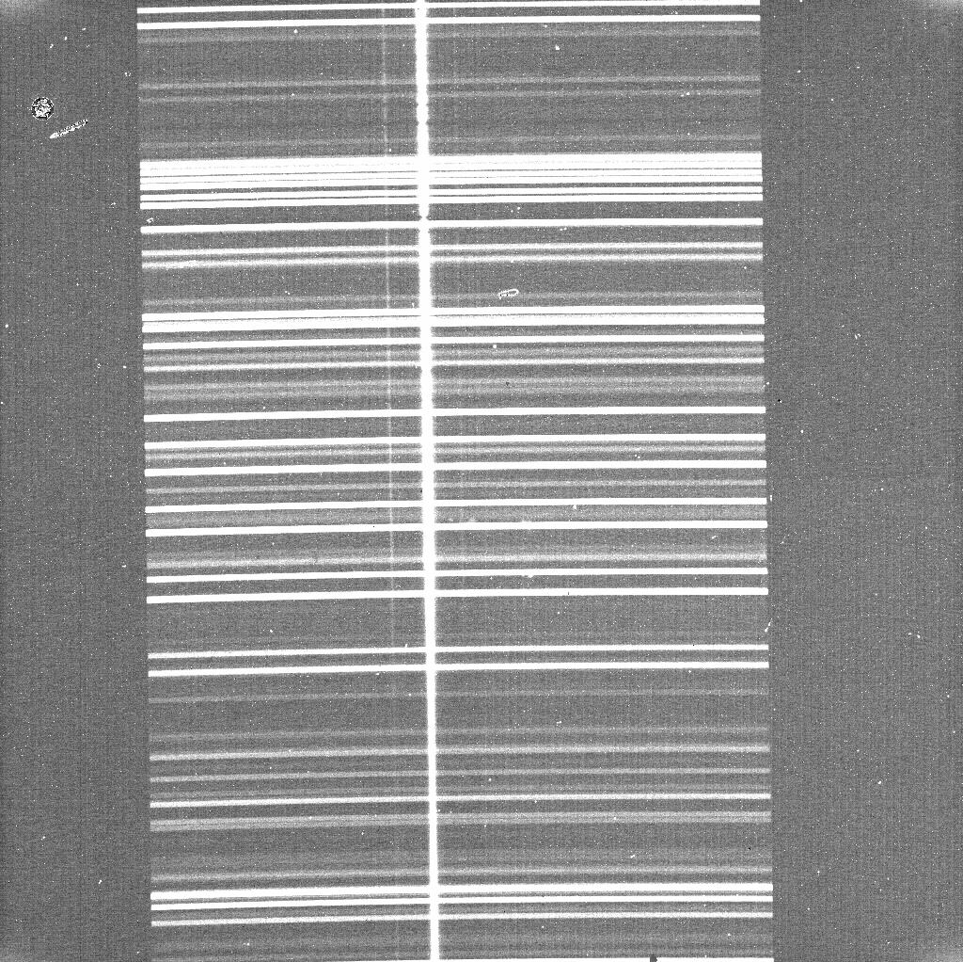
Spectroscopic Data
Spectroscopic data collected by the Gemini, MMT, and NASA’s Keck telescopes.

Slide 4
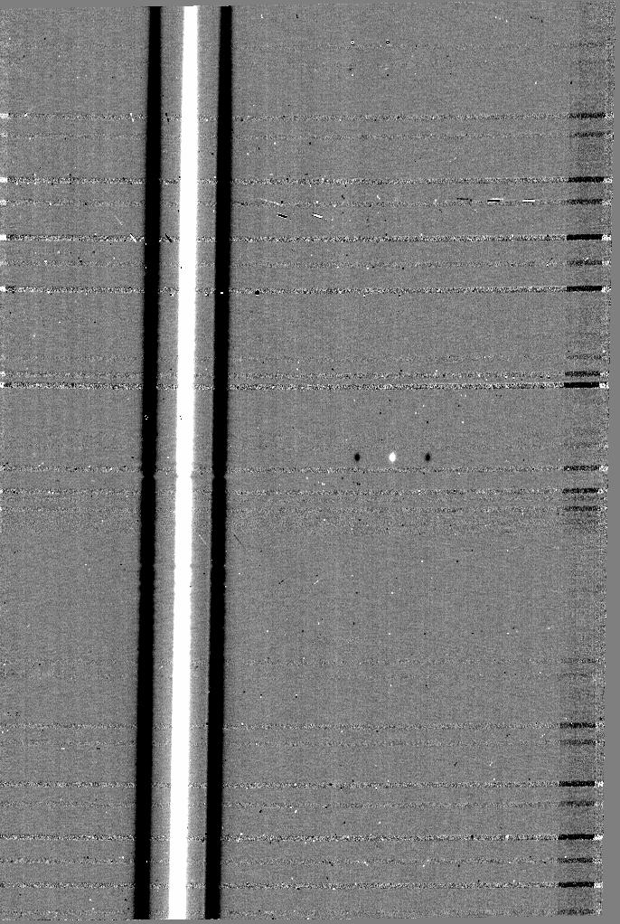
Data Reduction
Separate reduction pipeline for each data set.
Steps:
  Background subtraction
  Wavelength calibration with OH sky lines
  Image combination

Slide 5
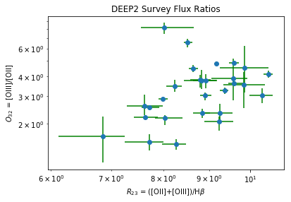

Results and Discussion
Metallicity parameters
  $R_{23}$ - ratio of Oxygen to Hydrogen line strengths
  $O_{32}$ - ratio of Oxygen line strengths
  $T_{e}$ - electron temperature

Slide 6
Acknowledgements
Dr. Chun Ly
Arizona Space Grant Consortium
UA Space Grant organizers

Slide 7
Thank You

